Slide 1
Market Outlook
Marketing material
08.06.2022, 16:00 CET
Please find important legal information at the end of this document.
Source: Bank Julius Baer & Co. Ltd. (Julius Baer), unless explicitly stated otherwise.

Slide 2
Contents
The Big Picture | 3
Latin america | 9
Portfolio construction | 14

Slide 3
The big picture

Slide 4
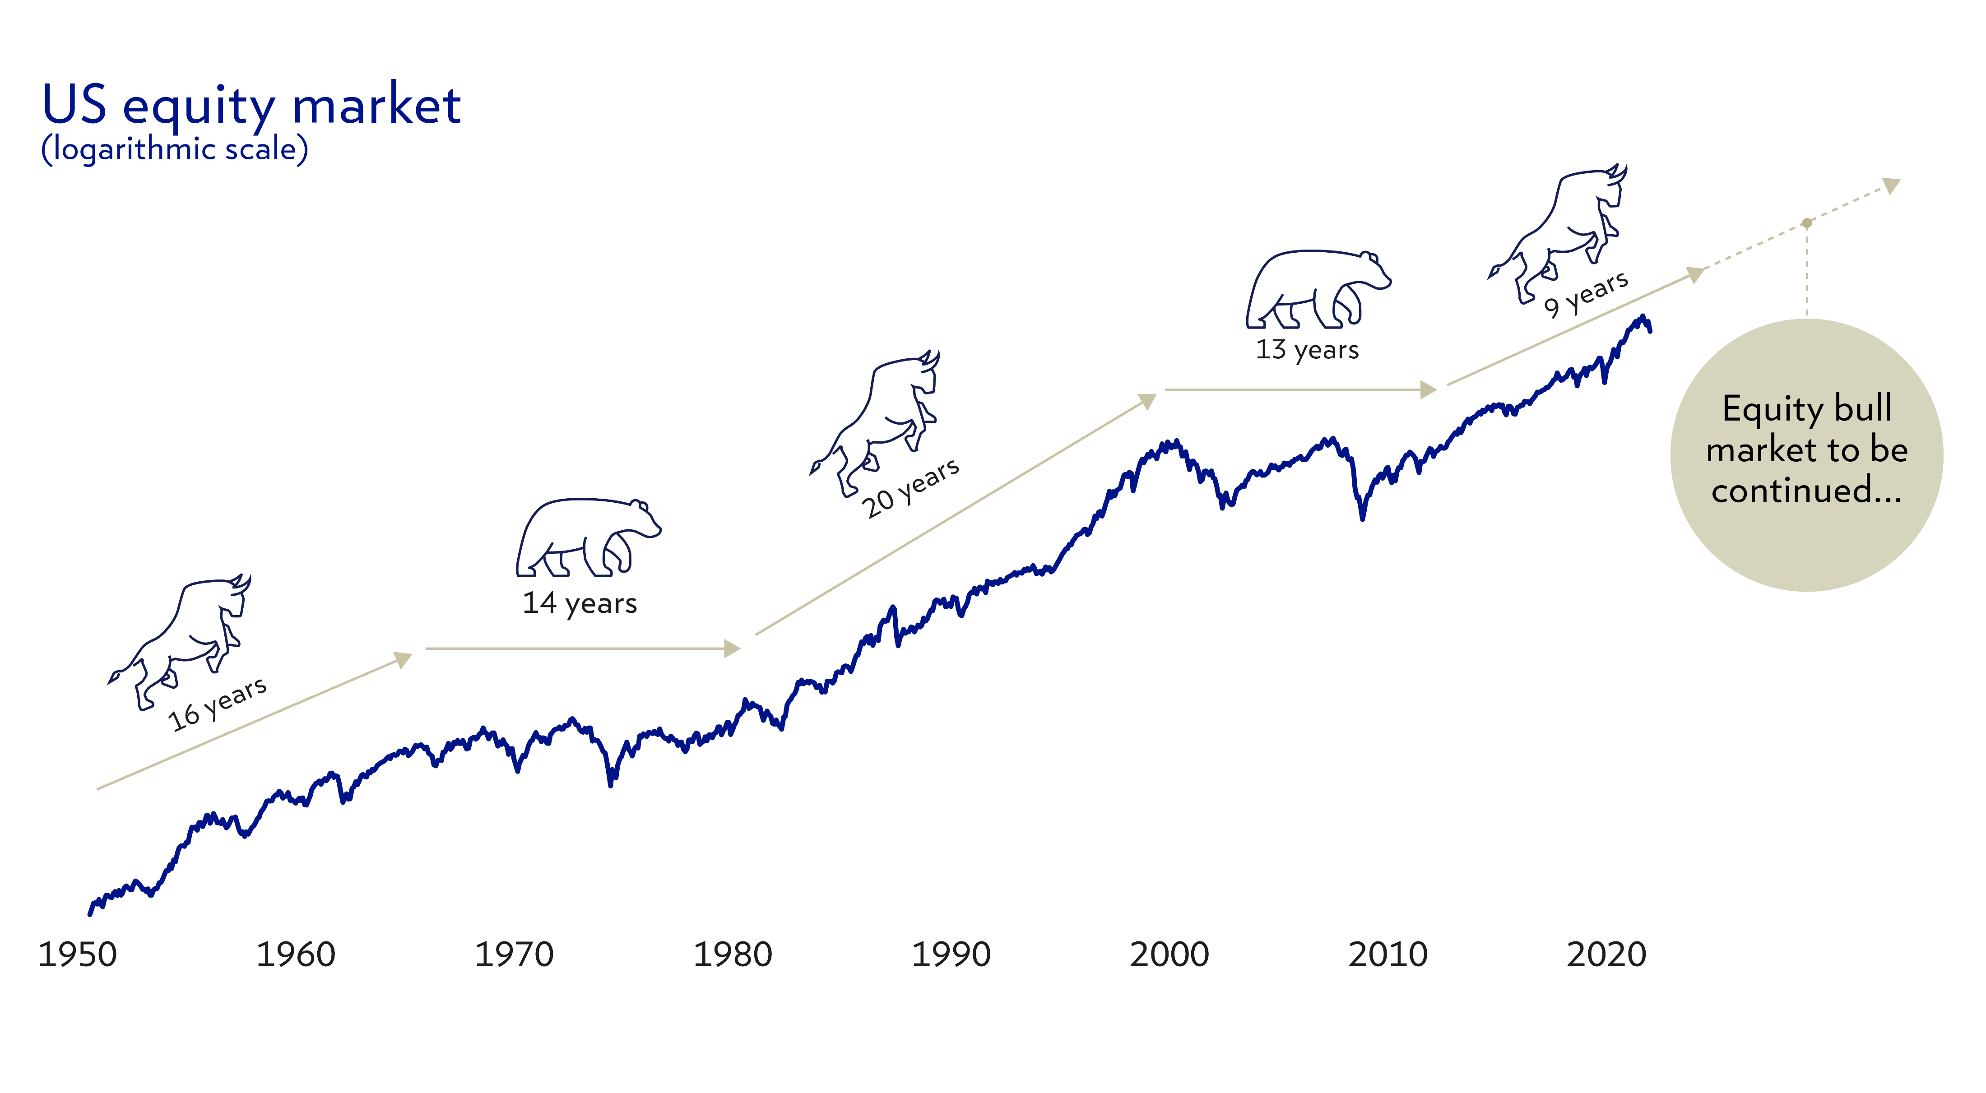
Stay the Course – We are likely still in a bull market
US equity market (S&P 500 on logarithmic scale)
Source: Bloomberg Finance L.P., Julius Baer Investment & Wealth Management Solutions. Past performance and performance forecasts are not reliable indicators of future results. The return may increase or decrease as a result of currency fluctuations.

Slide 5
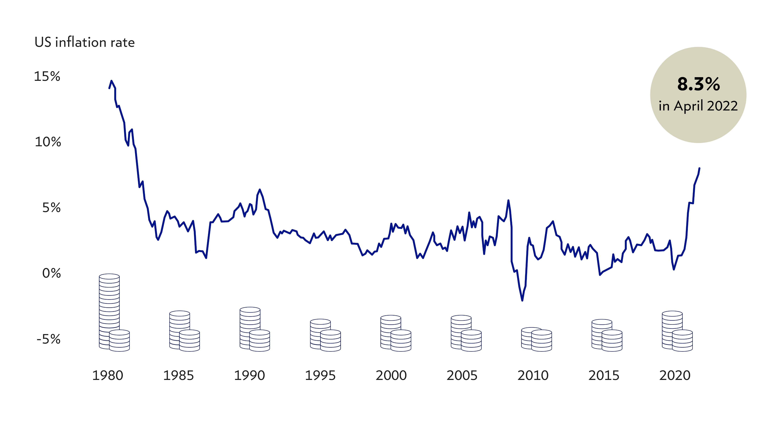
US inflation skyrocketed to a multi-year high
8.5%
July
Source: Bloomberg Finance L.P., Julius Baer Investment & Wealth Management Solutions

Slide 6
THE RISk Of a Recession is low
Corporate fundamentals are solid
Despite flattening yield curves, corporate funda- mentals argue against a recession
Source: Macrobond, Julius Baer Research; * models using the US yield curve, Baa corporate bond spreads, corporate earnings, and federal fund rates to forecast a recession in the next 12 months. Past performance is not a reliable indicator of future results. The return may increase or decrease as a result of currency fluctuations.

Slide 7
Inflation will stick around in 2022
Structural drivers currently point towards higher prices
Demographics
Supply-chain issues
Slowing globalisation
More fiscal transfers
Lasting loose monetary policy
Amplified by war
Amplified by war
Amplified by war
US headline inflation*
Recession after-effects
Productivity gains
Technology
Debt
Amplified by Covid
Amplified by Covid
Source: Refinitiv, Julius Baer Research; * arrows indicate the dominance of structural inflation (red) over deflation (beige) drivers.

Slide 8
Sharpest, fastest monetary tightening in historY
But the pace should slow down from now
Emerging market central banks
G10 central banks
Source: Macrobond, Julius Baer Research; * number of policy-rate increases (positive figure) or decreases (negative figure) in the preceding three months.

Slide 9
LATIN AMERICA

Slide 10
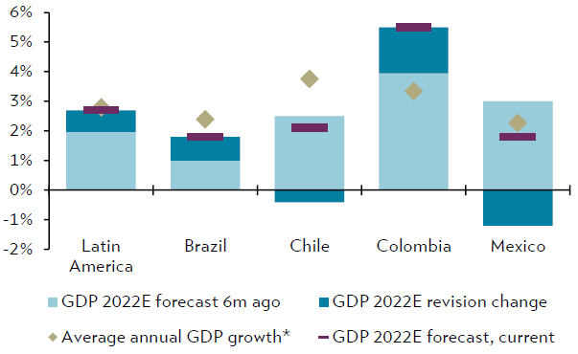
Growth linked to us and china
GDP of several countries remains below pre-pandemic trend
Source: Bloomberg Finance L.P., Julius Baer Research. * Average real GDP growth over the 25 years prior to the pandemic (1995-2019); GDP = gross domestic product, E = estimate, m = month

Slide 11
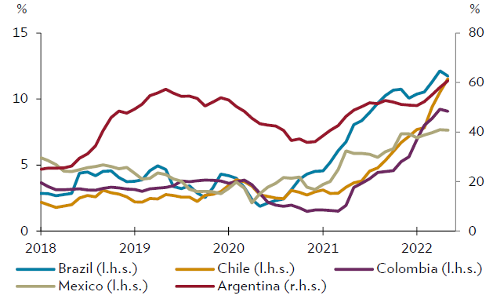
Inflation needs to be controlled
A slowdown of persistent inflation is expected in H2 2022
Source: Bloomberg Finance L.P., Julius Baer

Slide 12
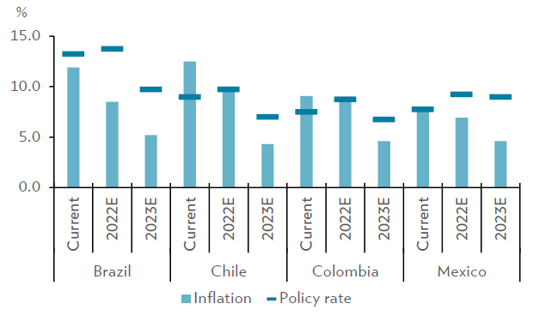
Will monetary policy hurt growth?
Advanced tightening cycle with rate-cut outlook in 2023
Source: Bloomberg Finance L.P., Julius Baer

Slide 13
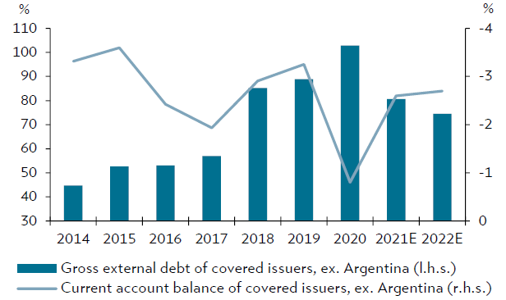
Will politics influence debt?
External debt increased already before the pandemic
Source: Bloomberg Finance L.P., International Monetary Fund, Julius Baer Covered issuers: Brazil, Chile, Colombia, and Mexico. Metrics as % of GDP

Slide 14
Portfolio construction

Slide 15
global bonds have been hit hard
The perfect storm
Investors need to be selective
Global bond index
Source: Bloomberg Finance L.P., Julius Baer Research. Global Bond index: Bloomberg Barclays aggregate global bond index (total return); Past performance and performance forecasts are not reliable indicators of future results. The return may increase or decrease as a result of currency fluctuations.

Slide 16
Equities are at an attractive Entry point
Valuations are back at historical averages
Developed market equities
Average
Source: Bloomberg Finance L.P., Julius Baer Research Past performance and performance forecasts are not reliable indicators of future results. The return may increase or decrease as a result of currency fluctuations.

Slide 17
commodities
We might be past the shock’s peak
Geopolitics / weather shock
War in Ukraine
Source: Bloomberg Finance L.P., Julius Baer Research. Commodity prices: Bloomberg Commodity Index, indexed to 2007–2015 range (in nominal terms). Past performance is not a reliable indicator of future results. The return may increase or decrease as a result of currency fluctuations.

Slide 18
sTrong USD
Impacted by safe-haven status and rates
US dollar index *
Source: Bloomberg Finance L.P., Julius Baer Research; * US-dollar trade-weighted index Past performance and performance forecasts are not reliable indicators of future results. The return may increase or decrease as a result of currency fluctuations.

Slide 19
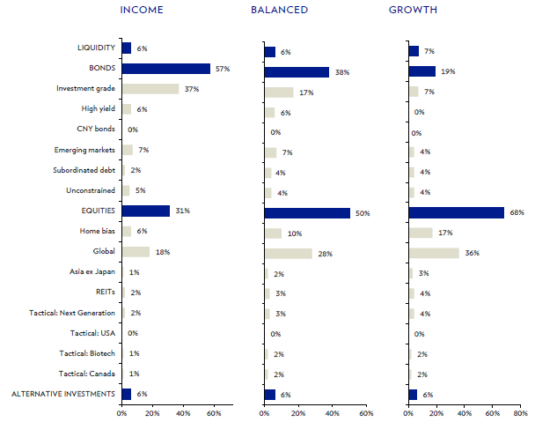
Strategic asset allocation
Dynamic Weightings
Source: Julius Baer

Slide 20
Market Outlook
Thank You!
08.06.2022, 16:00 CET
Please find important legal information at the end of this document.
Source: Bank Julius Baer & Co. Ltd. (Julius Baer), unless explicitly stated otherwise.

Slide 21
IMPORTANT LEGAL INFORMATION
IMPRINT
This document constitutes marketing material and is not the result of independent financial/investment research. It has therefore not been prepared in accordance with the legal requirements regarding the independence of financial/investment research and is not subject to any prohibition on dealing ahead of the dissemination of financial/investment research. It has been produced by Bank Julius Baer & Co. Ltd., Zurich, which is authorised and regulated by the Swiss Financial Market Supervisory Authority (FINMA).
Authors
Please add author name (first name/last name/function/e-mail address)¹⁾
¹⁾This author is employed by Bank Julius Baer & Co. Ltd., Zurich, which is authorised and regulated by the Swiss Financial Market Supervisory Authority (FINMA).
METHODOLOGIES AND GLOSSARY
Julius Baer: www.juliusbaer.com/en/legal/methodologies-and-glossary/
IMPORTANT LEGAL INFORMATION
The information and opinions expressed in this document were produced as at the date of writing and are subject to change without notice. This document is intended for information purposes only and does not constitute advice, an offer or an invitation by, or on behalf of, Julius Baer to buy or sell any securities, securities-based derivatives or other products or to participate in any particular trading strategy in any jurisdiction. Opinions and comments of the authors reflect their current views, but not necessarily of other Julius Baer entities or any other third party. Other Julius Baer entities may have issued, and may in the future issue, other documents that are inconsistent with, and reach different conclusions from, the information presented in this document. Julius Baer assumes no obligation to ensure that such other documents
be brought to the attention of any recipient of this document. Although the information herein is trusted to be accurate and complete and data herein has been obtained from sources believed to be reliable, no specific representation is made in this respect herein. In particular, the information provided in this document may not cover all material information on the financial instruments or issuers of such instruments. Julius Baer does not accept liability for any loss arising from the use of this document. Entities within the Julius Baer Group provide advice which is not considered ‘independent’ within the meaning given to that term by EU Directive 2014 / 65 / EU on markets in financial instruments (known as MiFID II).
SUITABILITY & SUSTAINABILITY
Suitability: Investments in the services and/or products mentioned in this document may not be suitable for all recipients and may not be available in all countries. Clients of Julius Baer are kindly requested to get in touch with the local Julius Baer entity in order to be informed about the services and/or products available in their country. Before entering into any transaction, investors should consider the suitability of the transaction to individual circumstances and objectives. Any investment or trading or other decision should only be made by the client after a thorough reading of the relevant product term sheet, subscription agreement, information memorandum, prospectus or other offering document relating to the issue of the securities or other financial instruments. Nothing in this document constitutes investment, legal, accounting or tax advice, or a representation that any investment or strategy is suitable or appropriate to individual circumstances, or otherwise constitutes a personal recommendation to any specific investor. Julius Baer recommends that investors independently assess, with a professional advisor, the specific financial risks as well as legal, regulatory, credit, tax, and accounting consequences. Where a document makes reference to a specific research report, the document should not be read in isolation without consulting the full research report, which may be

Slide 22
IMPORTANT LEGAL INFORMATION
provided upon request.
Sustainability: Depending on the recipient’s domicile or place of incorporation, this document may not adhere to any applicable existing or proposed principles, laws, rules, or regulations related to the environmental, social, and governance (ESG) criteria. For further details on ESG data, ESG methodology, and the existing legal/regulatory framework, as well as potential implications on financial return and eligible investments, please refer to the ‘ESG Disclaimer’: https://www. juliusbaer.com/esg-disclaimer-en
GENERAL RISKS
The price and value of, and income from investments in, any asset class mentioned in this document may fall as well as rise and investors may not get back the amount invested. Risks involved in any asset class mentioned in this document may include, but are not necessarily limited to, market risks, credit risks, political risks and economic risks. The investor may be exposed to currency risk when the product or underlyings of the product are denominated in currencies other than that of the country in which the investor is resident. The investment as well as its performance would therefore be exposed to currency fluctuations and may increase or decrease in value. Investments in emerging markets are speculative and may be considerably more volatile than investments in established markets. This document may include figures relating to simulated past performance. Past performance, simulations and performance forecasts are not reliable indicators of future results. The return may increase or decrease as a result of currency fluctuations. Shares, bank debt securities (e.g. interest-bearing bank bonds and certificates) as well as other claims against financial institutions are subject to special regulations, such as the Bank Recovery and Resolution Directive, the Single Resolution Mechanism Regulation and related national laws implementing such special regulations. These regulations
can have a negative effect for the investor / contractual partner of the financial institution in case of a default and the necessity of a resolution of the financial institution. For further details, please refer to: www.juliusbaer.com/legal-information-en
THIRD PARTY INFORMATION
This document may contain information obtained from third parties, including ratings from rating agencies such as Standard & Poor’s, Moody’s, Fitch and other similar rating agencies, and research from research providers such as MSCI ESG Research LLC or its affiliates as well as from index providers such as Bloomberg (as defined below). Issuers mentioned or included in any MSCI ESG Research LLC materials may be a client of, or affiliated with a client of MSCI Inc. (MSCI) or another MSCI subsidiary. “Bloomberg” refers to “Bloomberg®” and Bloomberg indices which are service marks of Bloomberg Finance L.P. and its affiliates, including Bloomberg Index Services Limited (BISL), as well as the administrator of the index. Bloomberg is not affiliated with Julius Baer.
Reproduction and distribution of third-party content in any form is prohibited except with the prior written permission of the related third party. Third party content providers do not guarantee the accuracy, completeness, timeliness or availability of any information, including ratings or research, and are not responsible for any errors or omissions (negligent or otherwise), regardless of the cause, or for the results obtained from the use of such content. Third-party content providers give no express or implied warranties, including, but not limited to, any warranties of merchantability or fitness for a particular purpose or use.
Third-party content providers shall not be liable for any direct, indirect, incidental, exemplary, compensatory, punitive, special or consequential damages, costs, expenses, legal fees, or losses (including lost income or profits and opportunity costs) in connection with any use of their content, including ratings or research. Third-party content providers do not approve, endorse, review, or recommend any services and/or products mentioned in this document. In particular, credit and/or research ratings

Slide 23
IMPORTANT LEGAL INFORMATION
are statements of opinions and are not statements of fact or recommendations to purchase, hold, or sell securities. They do not address the market value of securities or the suitability of securities for investment purposes and should not be relied on as investment advice.
IMPORTANT DISTRIBUTION INFORMATION
This document and any market data contained therein shall not be redistributed to any third party, unless Julius Baer or the source of the relevant market data gives their approval. This document is not directed to any person in any jurisdiction where (on the grounds of that person’s nationality, residence or otherwise) such documents are prohibited.
External Asset Managers (EAM)/External Financial Advisors (EFA): In case this document is provided to EAM/EFA, Julius Baer expressly prohibits its redistribution or any other way of making it available to clients and/or third parties. The document is of a purely abstract and general nature and is not intended for, nor directed at, client portfolios in general or clients domiciled in the European Economic Area in particular. By receiving any document, the EAM/EFA confirms that they will make their own independent analysis and investment decisions, where applicable.
Switzerland: This document is distributed by Bank Julius Baer & Co. Ltd., Zurich, authorised and regulated by the Swiss Financial Market Supervisory Authority (FINMA).
UNITED STATES: NEITHER THIS DOCUMENT NOR ANY COPY THEREOF MAY BE SENT, TAKEN INTO OR DISTRIBUTED IN THE UNITED STATES OR TO ANY US PERSON.
© Julius Baer Group, 2022

Slide 24
JULIUS BAER GROUP
Head Office
Bahnhofstrasse 36
P.O. Box
8010 Zurich
Switzerland
Telephone +41 (0) 58 888 1111
Fax +41 (0) 58 888 1122
www.juliusbaer.com
The Julius Baer Group
is present in more than
60 locations worldwide,
including Zurich (Head Office),
Dubai, Dublin, Frankfurt, Geneva,
Hong Kong, London, Lugano,
Luxembourg, Madrid, Mexico City, Monaco, Mumbai, Santiago de Chile, São Paolo, Shanghai,
Singapore, and Tel Aviv.
06.2022
© JULIUS BAER GROUP, 2022

