Slide 1
Swiss Free Trade Policy in Practice
Markus Schlagenhof
Ambassador, Delegate of the Federal Council for Trade Agreements and head of the World Trade Division
State Secretariat for Economic Affairs SECO
LATCAM Webinar
July 9, 2020

Slide 2
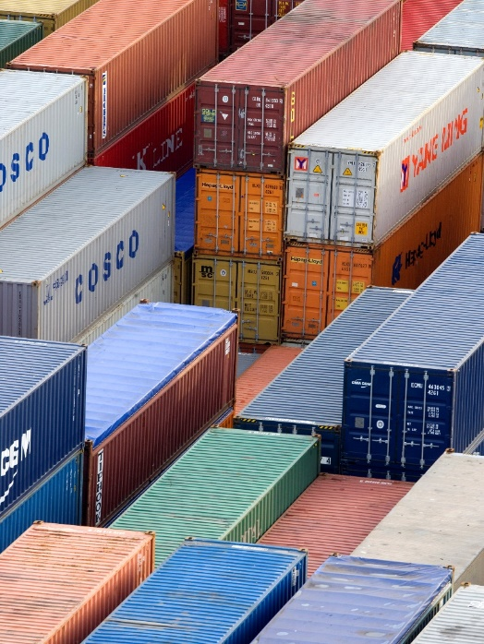
Swiss Economy Dependent on Global Markets
Switzerland is an exporting nation
Dependent on international value chains
Dependent on Free Trade Agreements
Competitors like EU are active
Potential for discrimination in Switzerland

Slide 3
Swiss Trade Policy
Three pillars of the Swiss market access policy
WTO
Bilateral Agreements with the EU
FTAs with Non-EU partners
Free Trade Agreements (FTAs) as an instrument
of the Swiss market access policy

Slide 4
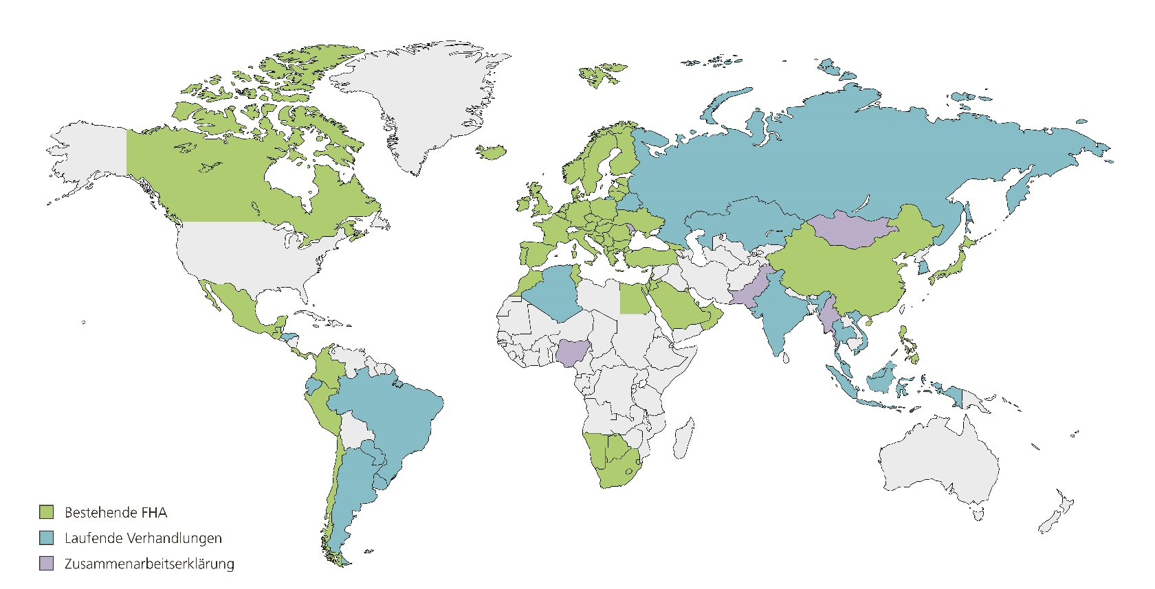
Network of FTAs: 30 FTAs (in force) with 40 Partners
FTAs in force
Ongoing negotiations
Declaration of cooperation

Slide 5
Impact of FTAs for CH
FTAs cover 23% of Switzerland's total trade
Positive influence on growth, market access and investment and strengthening of Switzerland’s competitiveness
Greater transparency and legal certainty
Prevention of discrimination
Institutional security from stronger relationship with partners
Diversification of economic relations

Slide 6
Switzerland’s priorities in FTAs
Market access
Trade Facilitation
Financial services
Investment
Intellectual property rights
Government procurement
Trade and sustainable development

Slide 7
EFTA-Mercosur FTA
Launch of negotiations: June 2017
Ten negotiation rounds: Agreement in substance August 2019
Gradual liberalization of 95% of Swiss goods exports
First time Switzerland granted bilateral quotas for sensitive agricultural products
Comprehensive chapter on trade and sustainable development

Slide 8
Current political situation in Switzerland
Shift towards green parties in last year’s election
Political pressure for stronger sustainability provisions in FTAs
Critical public reaction to conclusion of negotiations with Mercosur
Referendum against agreement with Indonesia

Slide 9
Next steps for EFTA-MCS FTA
Agreement in substance in August 2019
Legal review currently ongoing
Signing of agreement
Internal approval processes
Entry into force

Slide 10
Questions?

Slide 11
Thank you for your attention!
markus.schlagenhof@seco.admin.ch

